Slide 1

Detecting objects with deep learning hammer
Tao Kong
https://taokong.github.io/

Slide 2
Outline
The object detection problem
Traditional methods (before 2014)
Modern object detection frameworks
Other useful resources

Slide 3
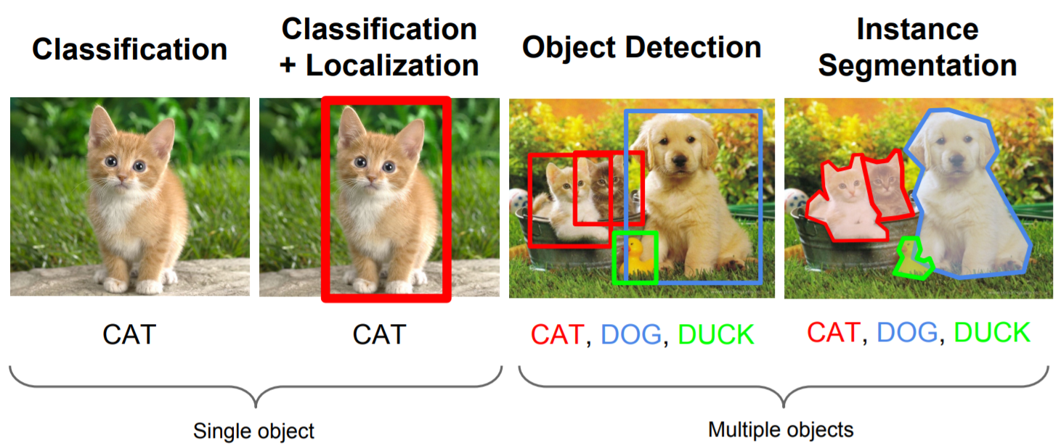
Basic computer vision tasks

Slide 4


Detection problem
Classifier must generalize over all exemplars of one class.
Negative class consists of everything else.
High accuracy (small FP rate) required for most applications.

Slide 5
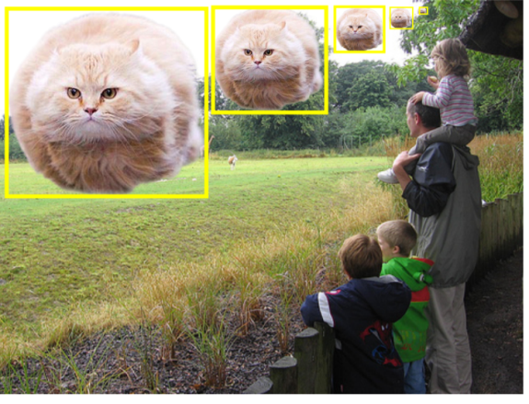
Detection challenges
Object scales?
Negative spaces?
Object variations?

Slide 6
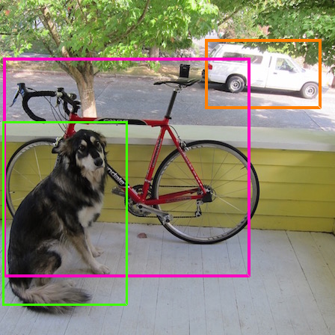
Detection challenges
Object scales?
Negative spaces?
Object variations?

Slide 7
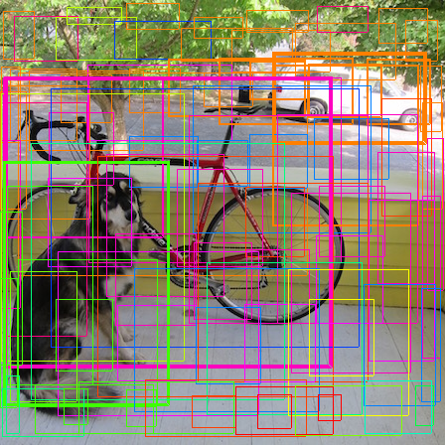
Detection challenges
Object scales?
Negative spaces?
Object variations?

Slide 8
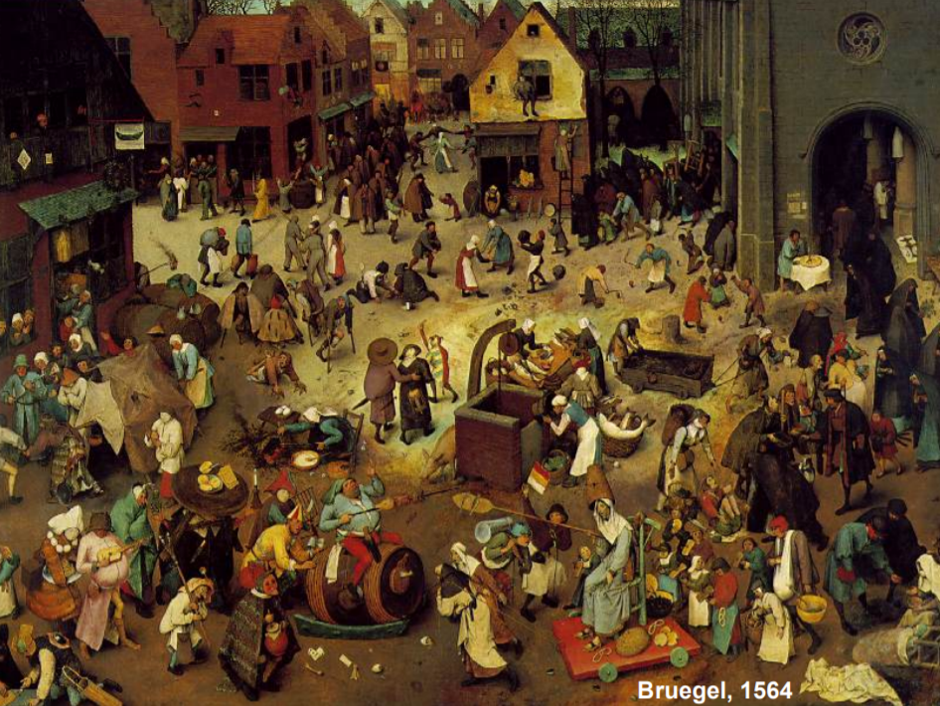
Detection challenges
Object scales?
Negative spaces?
Object variations?

Slide 9
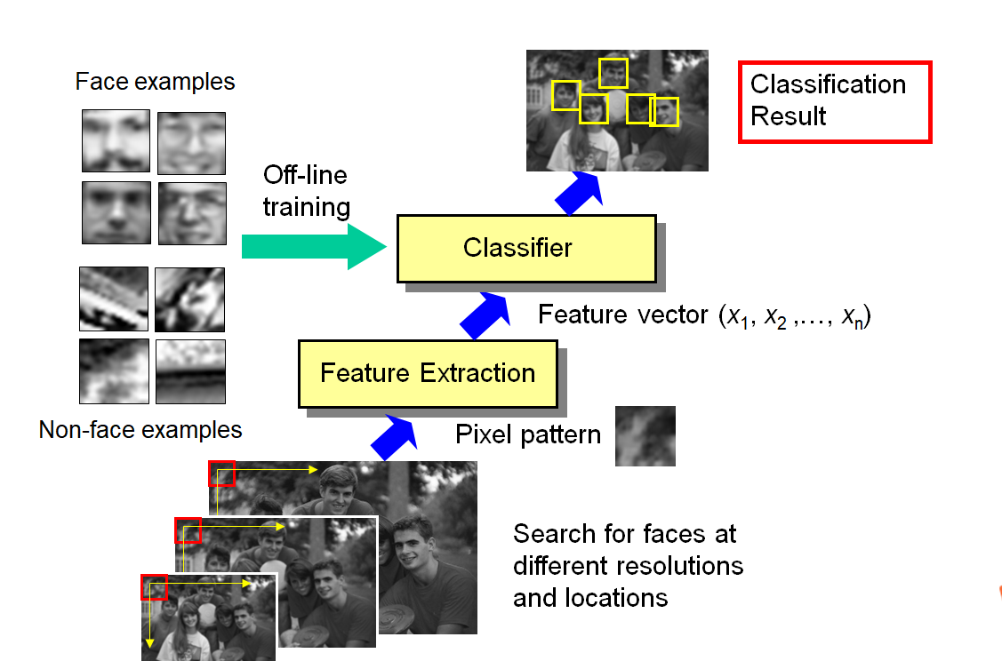
Face Detection – basic scheme
Sliding windows
Off-line training
Better Features
Better Classifiers
Better sliding windows

Slide 10
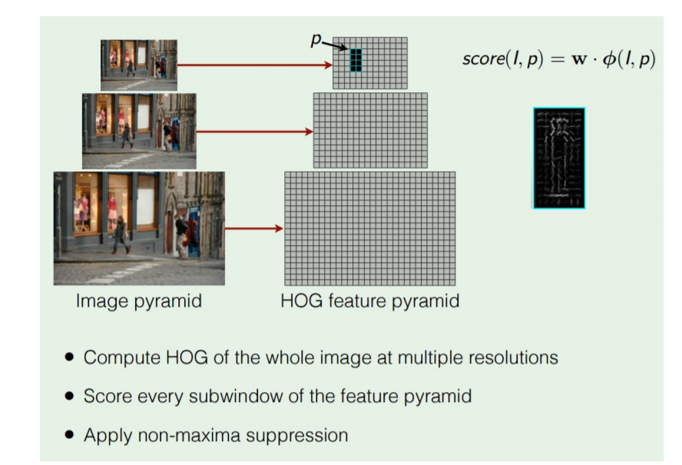
Face Detection – basic scheme
Histogram of Oriented Gradients
output
Sliding window classifier
Feature (pyramid) on whole image
Input image

Slide 11
How to do object detection with deep leaning(ConvNet)?

Slide 12
ConvNet

Slide 13
ConvNet
Too much searching space
(1w-10w windows)

Slide 14

Region proposals
Find image regions that are likely to contain objects
“Class-agnostic” object detector
Look for “blob-like” regions

Slide 15
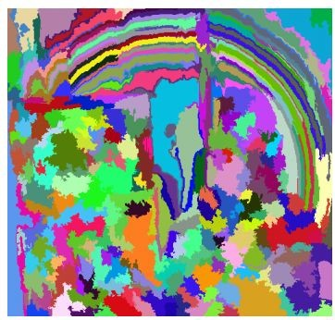
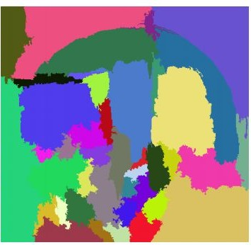
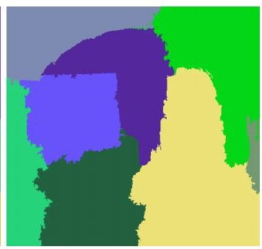
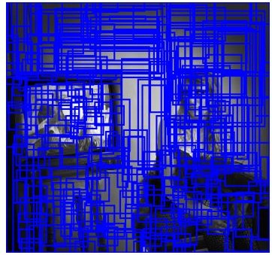
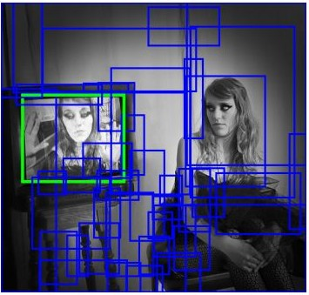
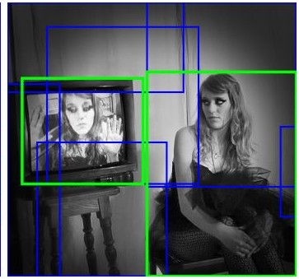
Region proposals: selective search
Bottom-up segmentation, merging regions at multiple scales
Convert regions to boxes
Uijlings et al, “Selective Search for Object Recognition”, IJCV 2013

Slide 16
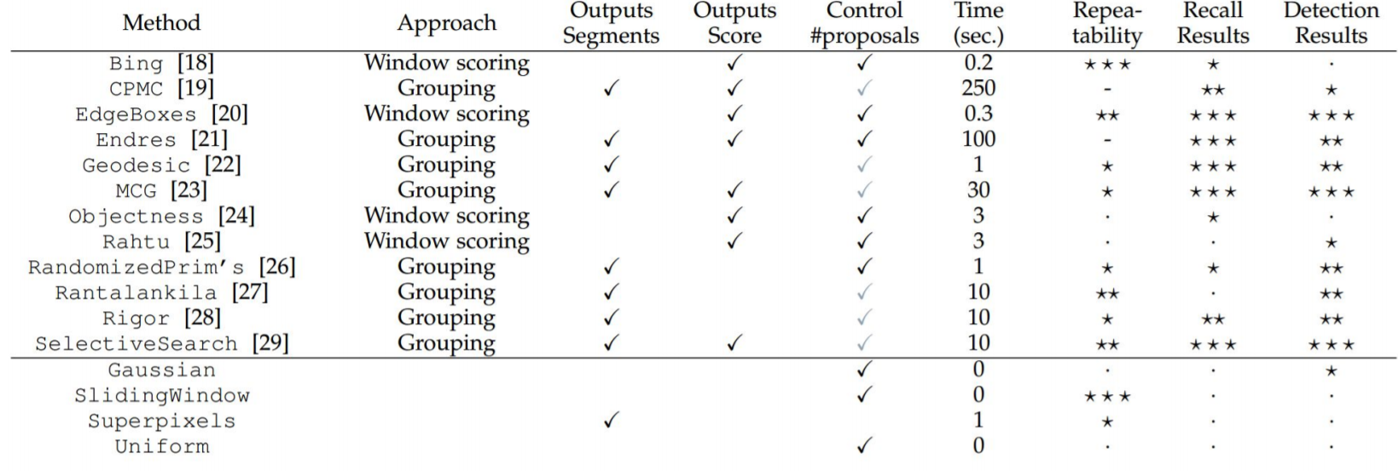
Region proposals: other choices
Hosang et al, “What makes for effective detection proposals?”, PAMI 2015

Slide 17
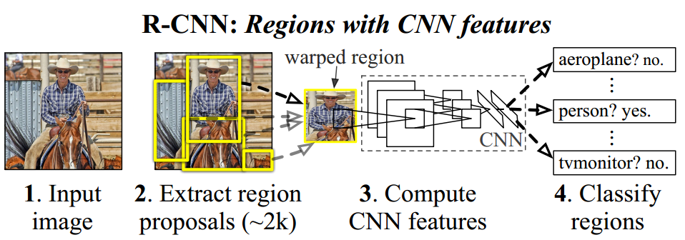
R-CNN:
R. Girshick, J. Donahue, T. Darrell, J. Malik. Rich feature hierarchies for accurate object detection and semantic segmentation. In CVPR 2014. (oral)

Slide 18
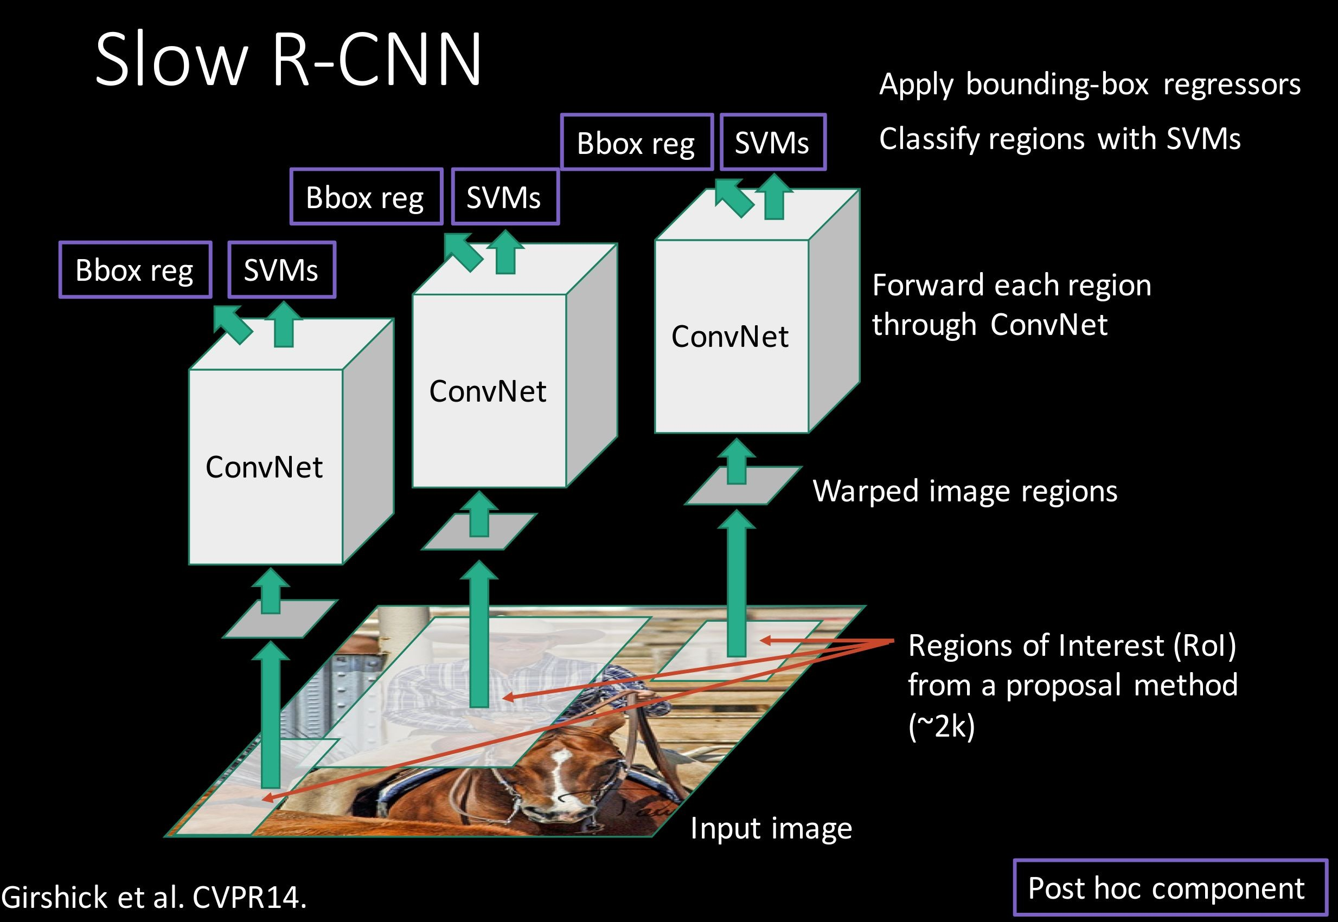
R-CNN: Another view

Slide 19

R-CNN: Training
Step 1: Train (or download) a classification model for ImageNet (AlexNet)
Convolution and Pooling
Fully-connected layers
Softmax loss
Final conv feature map
Class scores 1000 classes
Image

Slide 20
R-CNN: Training
Step 2: Fine-tune model for detection
Instead of 1000 ImageNet classes, want 20 object classes + background
Throw away final fully-connected layer, reinitialize from scratch
Keep training model using positive / negative regions from detection images
Re-initialize this layer: was 4096 x 1000,
now will be 4096 x 21
Convolution and Pooling
Fully-connected layers
Softmax loss
Final conv feature map
Class scores: 21 classes
Image

Slide 21



R-CNN: Training
Step 3: Extract features
Extract region proposals for all images
For each region: warp to CNN input size, run forward through CNN, save pool5 features to disk
Have a big hard drive: features are ~200GB for PASCAL dataset!
Convolution
pool5 features
Image
Region Proposals
Crop + Warp
Forward pass
Save to disk

Slide 22

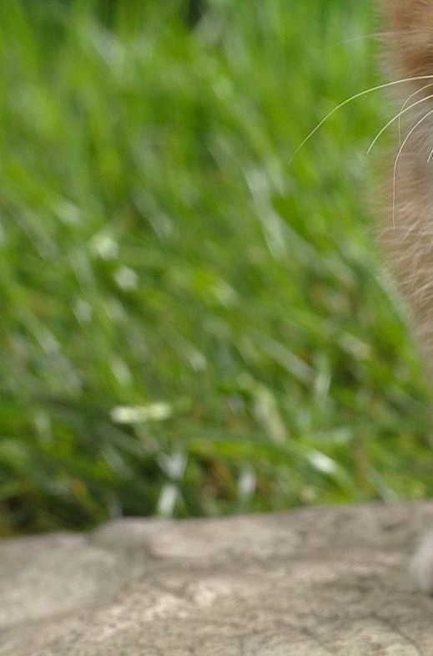




R-CNN: Training
Step 4: Train one binary SVM per class to classify region features
Training image regions
Cached region features
Positive samples for cat SVM
Negative samples for cat SVM

Slide 23



R-CNN: Training
Step 5 (bbox regression): For each class, train a linear regression model to map from cached features to offsets to GT boxes to make up for “slightly wrong” proposals
Training image regions
Cached region features
Regression targets (dx, dy, dw, dh)
Normalized coordinates
(0, 0, 0, 0)
Proposal is good
(.25, 0, 0, 0)
Proposal too far to left
(0, 0, -0.125, 0)
Proposal too wide

Slide 24
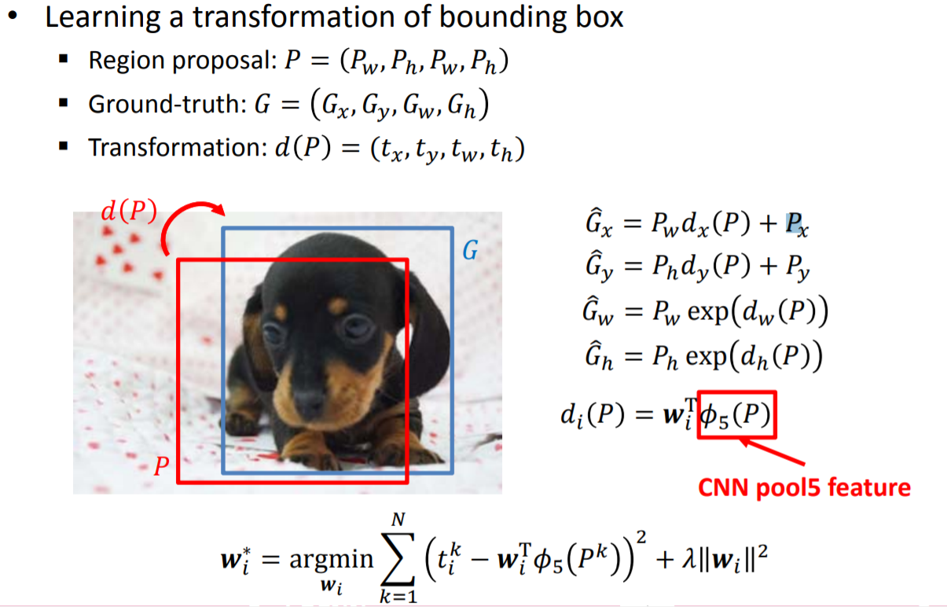
R-CNN: Bounding Box Regression

Slide 25
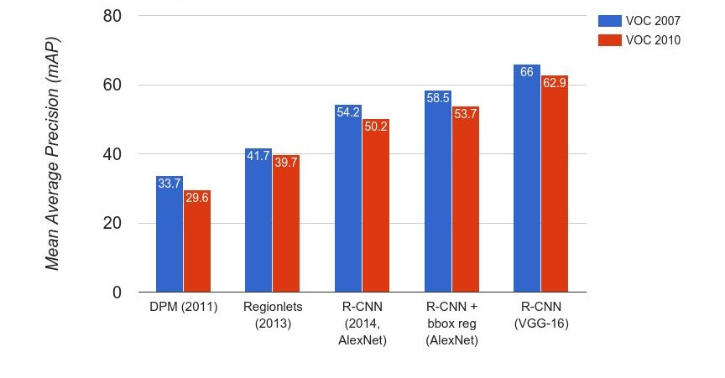
R-CNN: Results

Slide 26
Object detection: benchmarks
 | PASCAL VOC (2010) | ImageNet Detection (ILSVRC 2014) | MS-COCO (2014)
Number of classes | 20 | 200 | 80
Number of images (train + val) | ~20k | ~470k | ~120k
Mean objects per image | 2.4 | 1.1 | 7.2

Slide 27
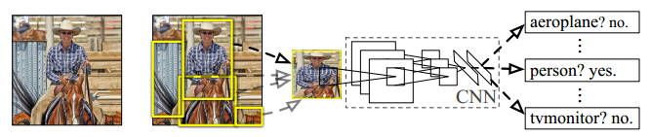
R-CNN: Disadvantages
Training and testing is expensive in space and time.
Why: for each image, one need to extract CNN features for about 2k object proposals and make classification. But the features are shared in space.
Relays on the region proposal method(selective search)
Training is a multi-stage pipeline

Slide 28
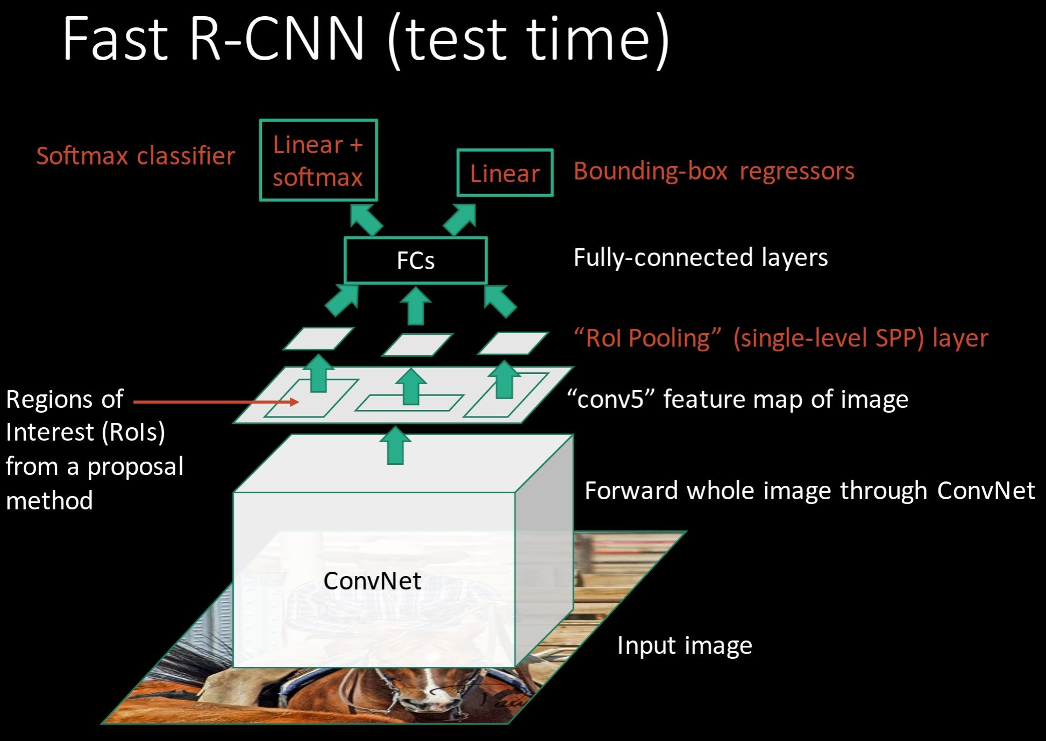
Fast R-CNN

Slide 29
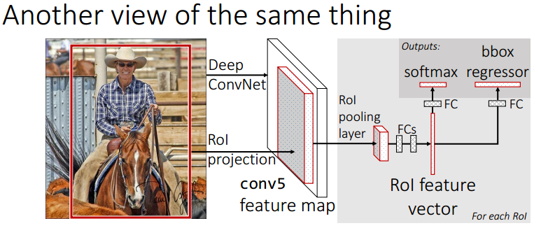
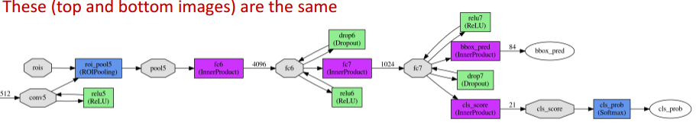

Slide 30

R-CNN Problem #1: Slow at test-time due to independent forward passes of the CNN
Solution:
Share computation of convolutional layers between proposals for an image
Fei-Fei Li & Andrej Karpathy & Justin Johnson Lecture 8 - 1 Feb 2016
Lecture 8 - 68

Slide 31
R-CNN Problem #1: Slow at test-time due to independent forward passes of the CNN
Solution:
Share computation of convolutional layers between proposals for an image
Fei-Fei Li & Andrej Karpathy & Justin Johnson Lecture 8 - 1 Feb 2016
Lecture 8 - 68

Slide 32
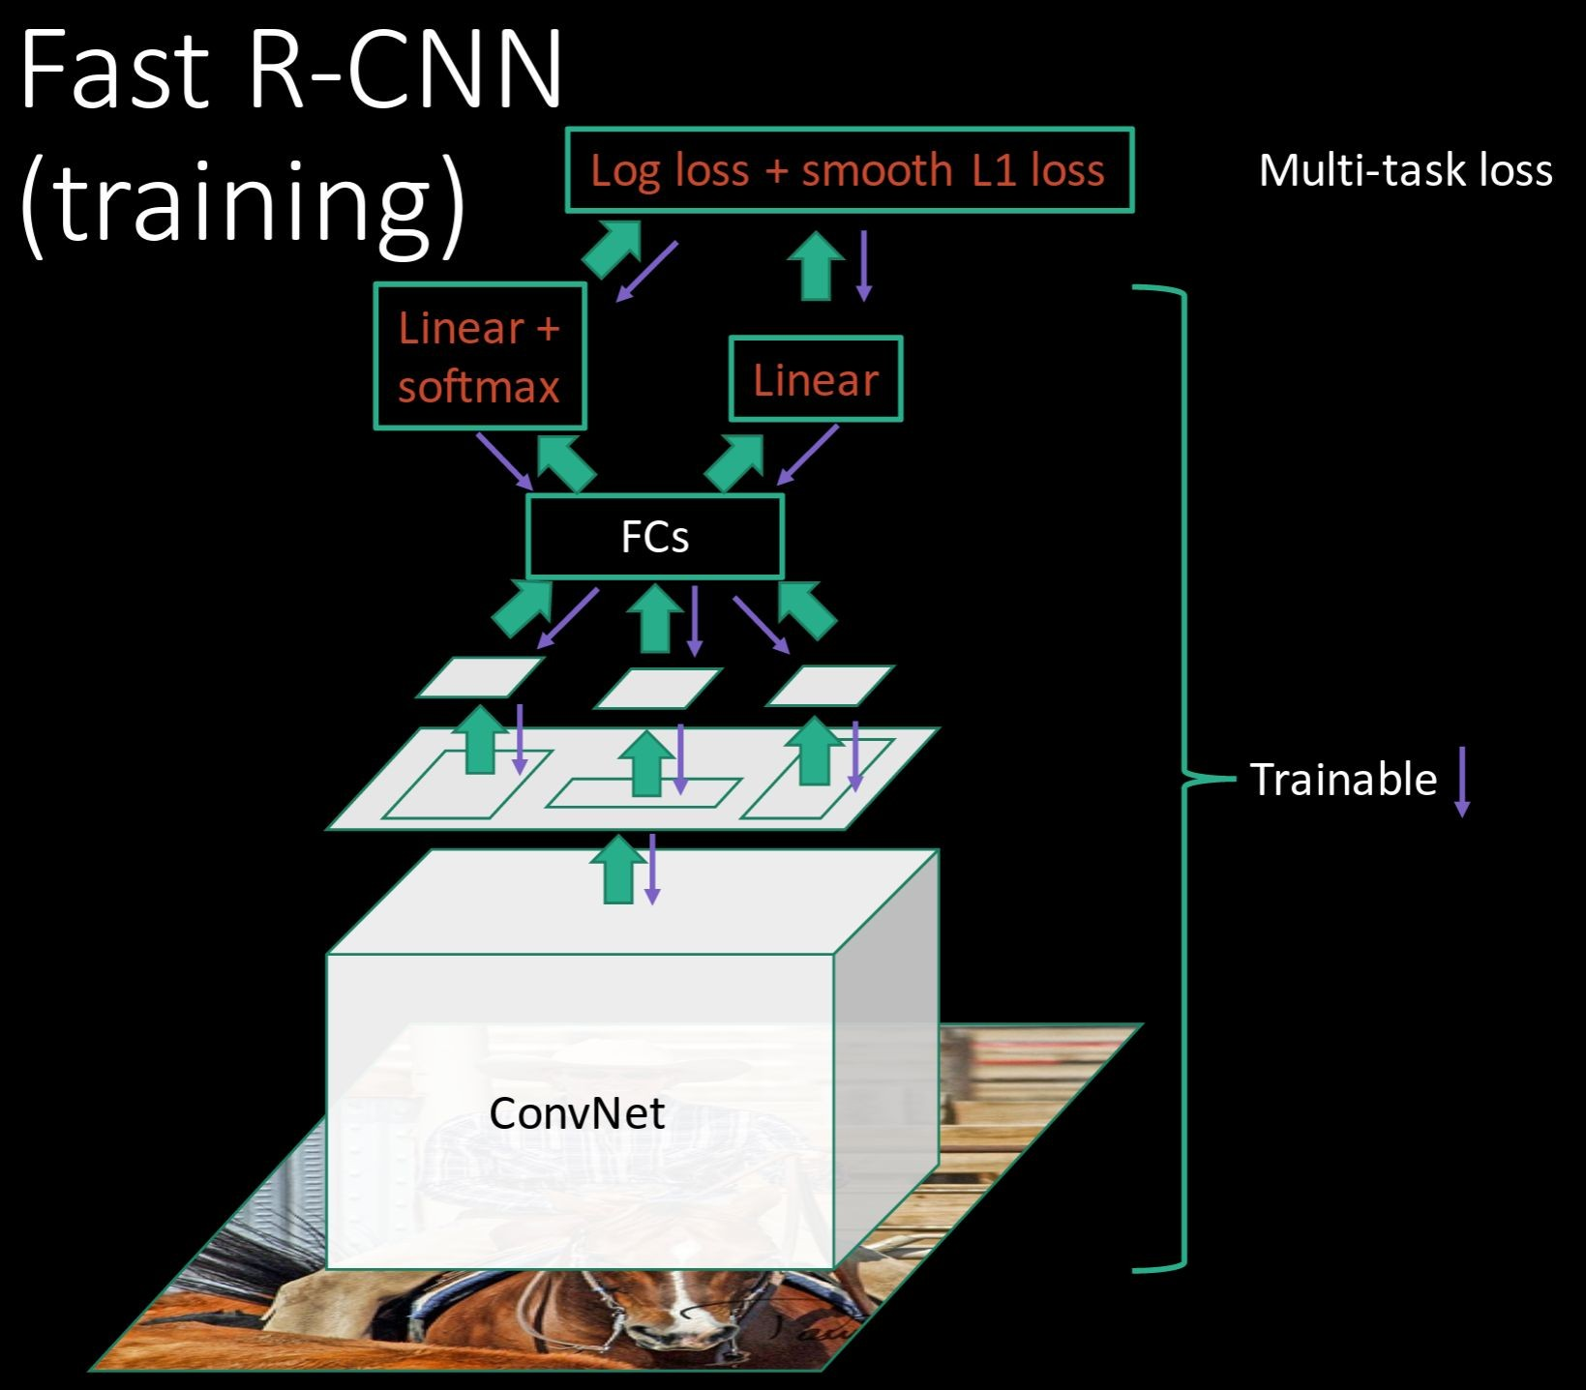
R-CNN Problem #2:
Post-hoc training: CNN not updated in response to final classifiers and regressors
R-CNN Problem #3:
Complex training pipeline
Solution:
Just train the whole system end-to-end all at once!
Slide credit: Ross Girschick
Fei-Fei Li & Andrej Karpathy & Justin Johnson Lecture 8 - 1 Feb 2016
Lecture 8 - 69

Slide 33
Fast R-CNN: Region of Interest Pooling
Convolution and Pooling
Fully-connected layers
Hi-res input image: 3 x 800 x 600
with region proposal
Hi-res conv features:
C x H x W
with region proposal
Problem: Fully-connected layers expect low-res conv features: C x h x w
Fei-Fei Li & Andrej Karpathy & Justin Johnson Lecture 8 - 1 Feb 2016
Lecture 8 - 70

Slide 34
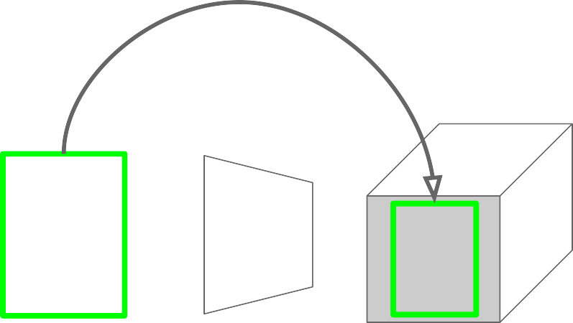
Fast R-CNN: Region of Interest Pooling
Project region proposal onto conv feature map
Convolution and Pooling
Fully-connected layers
Hi-res input image: 3 x 800 x 600
with region proposal
Hi-res conv features:
C x H x W
with region proposal
Problem: Fully-connected layers expect low-res conv features: C x h x w
Fei-Fei Li & Andrej Karpathy & Justin Johnson Lecture 8 - 1 Feb 2016
Lecture 8 - 71

Slide 35
Fast R-CNN: Region of Interest Pooling
Convolution and Pooling
Divide projected region into h x w grid
Fully-connected layers
Hi-res input image: 3 x 800 x 600
with region proposal
Hi-res conv features:
C x H x W
with region proposal
Problem: Fully-connected layers expect low-res conv features: C x h x w
Fei-Fei Li & Andrej Karpathy & Justin Johnson Lecture 8 - 1 Feb 2016
Lecture 8 - 72

Slide 36
Fast R-CNN: Region of Interest Pooling
Max-pool within
Convolution and Pooling
each grid cell
Fully-connected layers
Hi-res input image: 3 x 800 x 600
with region proposal
Hi-res conv features:
C x H x W
with region proposal
RoI conv features:
C x h x w
for region proposal
Fully-connected layers expect low-res conv features:
C x h x w
Fei-Fei Li & Andrej Karpathy & Justin Johnson Lecture 8 - 1 Feb 2016
Lecture 8 - 73

Slide 37
Fast R-CNN: Region of Interest Pooling
Can back propagate
Convolution and Pooling
similar to max pooling
Fully-connected layers
Hi-res input image: 3 x 800 x 600
with region proposal
Hi-res conv features:
C x H x W
with region proposal
RoI conv features:
C x h x w
for region proposal
Fully-connected layers expect low-res conv features:
C x h x w
Fei-Fei Li & Andrej Karpathy & Justin Johnson Lecture 8 - 1 Feb 2016
Lecture 8 - 74

Slide 38
Fast R-CNN Results
 | R-CNN | Fast R-CNN
Training Time: | 84 hours | 9.5 hours
(Speedup) | 1x | 8.8x
Test time per image | 47 seconds | 0.32 seconds
(Speedup) | 1x | 146x
mAP (VOC 2007) | 66.0 | 66.9
Faster!
FASTER!
Better!
Using VGG-16 CNN on Pascal VOC 2007 dataset

Slide 39
Fast R-CNN Problem:
Test-time speeds don’t include region proposals
 | R-CNN | Fast R-CNN
Test time per image | 47 seconds | 0.32 seconds
(Speedup) | 1x | 146x
Test time per image with Selective Search | 50 seconds | 2 seconds
(Speedup) | 1x | 25x

Slide 40
Fast R-CNN Problem Solution:
Test-time speeds don’t include region proposals
Just make the CNN do region proposals too!
 | R-CNN | Fast R-CNN
Test time per image | 47 seconds | 0.32 seconds
(Speedup) | 1x | 146x
Test time per image with Selective Search | 50 seconds | 2 seconds
(Speedup) | 1x | 25x

Slide 41
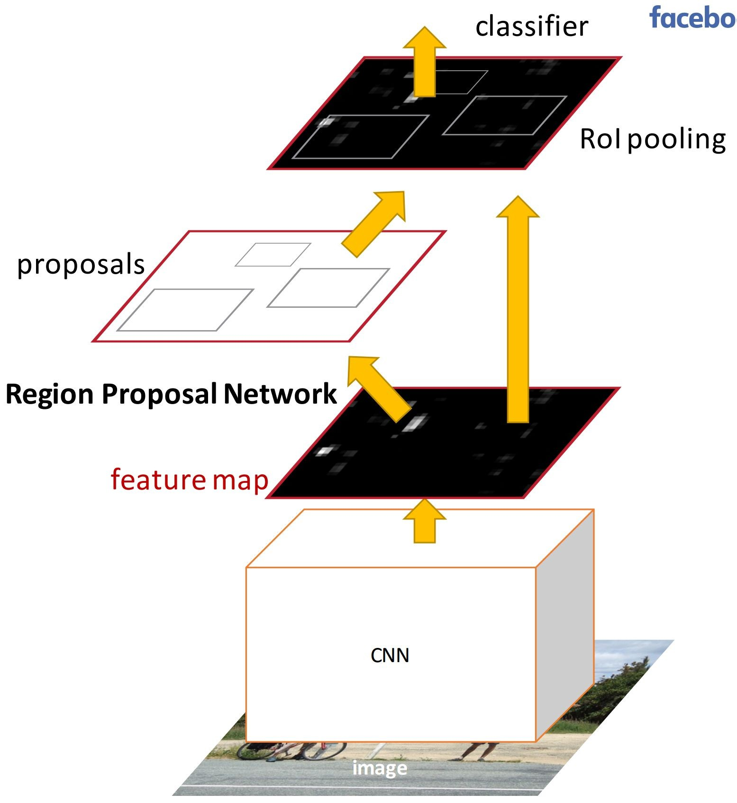
Faster R-CNN

Slide 42
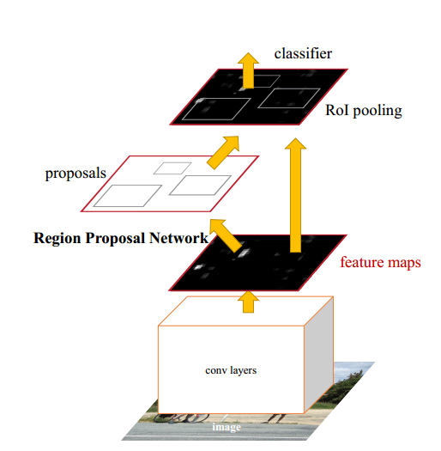
Faster R-CNN
Region Proposal Net
+
Fast RCNN
This part is New!
There are simple Fast RCNN

Slide 43
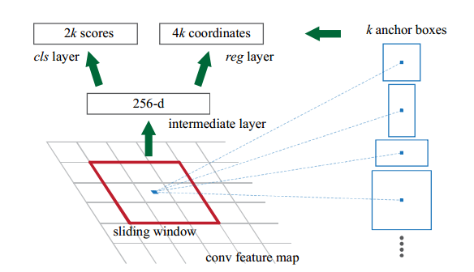
Faster R-CNN: Region Proposal Network
Input an image of any size
Generate conv feature map
Map to a lower-dimensional feature
Output objectness score and bounding box
The region proposal network is a FCN which outputs K*(4+2) sized vectors.

Slide 44
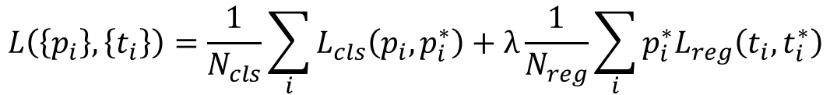
Faster R-CNN: Region Proposal Network
LOSS
Positive: Among K anchors, one with highest IOU (IOU>=0.7)
Negative:IOU<=0.3
Others: Do not contribute
$$L\left(\left\{p_{i}\right\},\left\{t_{i}\right\}\right)=\frac{1}{N_{cls}}\sum_{i}{L_{cls}\left(p_{i},p_{i}^{∗}\right)+λ\frac{1}{N_{reg}}\sum_{i}{p_{i}^{∗}L_{reg}\left(t_{i},t_{i}^{∗}\right)}}$$
The mini-batch size(256)
The number of anchor locations(~2400)

Slide 45
Faster R-CNN: Results
 | R-CNN | Fast R-CNN | Faster R-CNN
Test time per image (with proposals) | 50 seconds | 2 seconds | 0.2 seconds
(Speedup) | 1x | 25x | 250x
mAP (VOC 2007) | 66.0 | 66.9 | 66.9

Slide 46
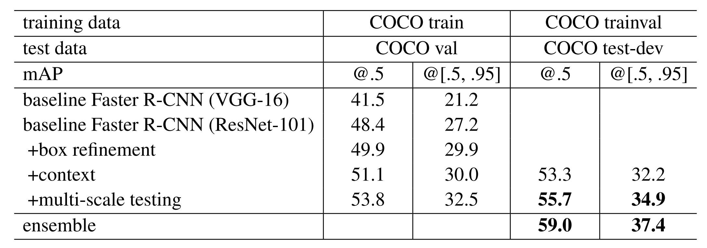
Object Detection State-of-the-art: ResNet 101 + Faster R-CNN + some extras
He et. al, “Deep Residual Learning for Image Recognition”, arXiv 2015

Slide 47
Faster R-CNN: Results
 | R-CNN | Fast R-CNN | Faster R-CNN
Test time per image (with proposals) | 50 seconds | 2 seconds | 0.2 seconds
(Speedup) | 1x | 25x | 250x
mAP (VOC 2007) | 66.0 | 66.9 | 66.9

Slide 48

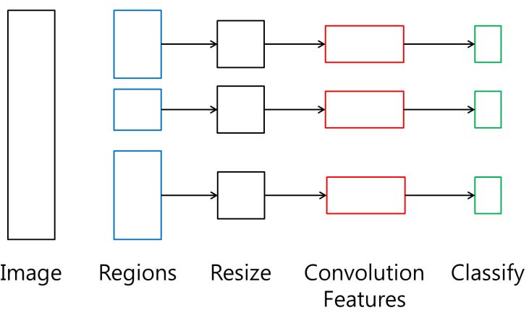
R-CNN, Fast R-CNN and Faster R-CNN
R-CNN

Slide 49
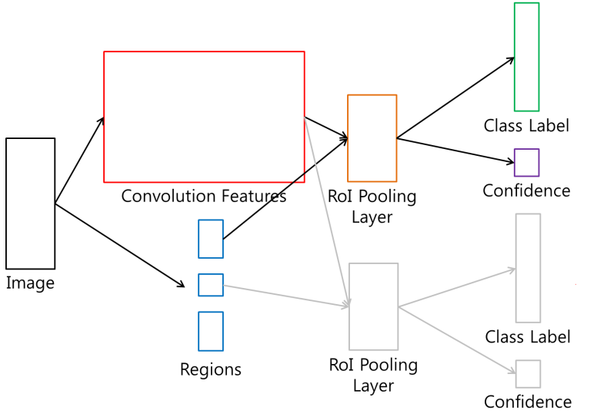
R-CNN, Fast R-CNN and Faster R-CNN
Fast R-CNN
output
Sliding window classifier
Feature (pyramid) on whole image
Input image

Slide 50
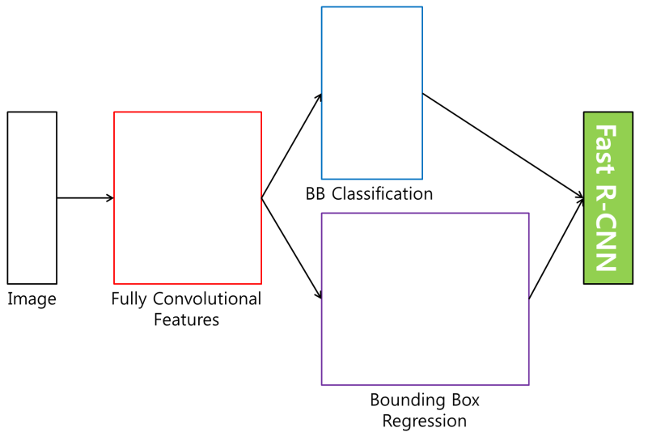
R-CNN, Fast R-CNN and Faster R-CNN
Faster R-CNN
output
Sliding window classifier
Feature (pyramid) on whole image
Input image

Slide 51
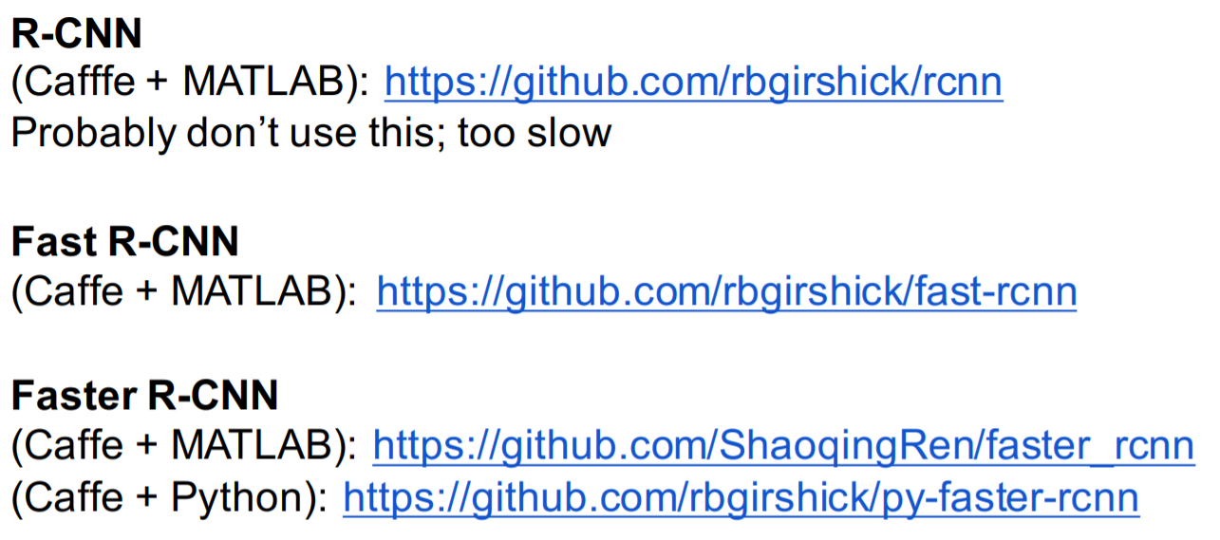
Object Detection code links:

Slide 52
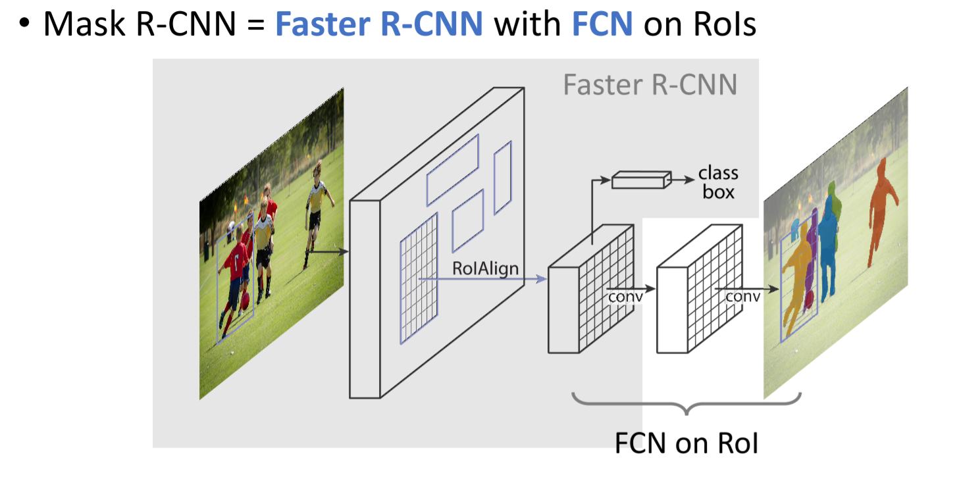
Mask R-CNN

Slide 53
What is the latest news?

Slide 54
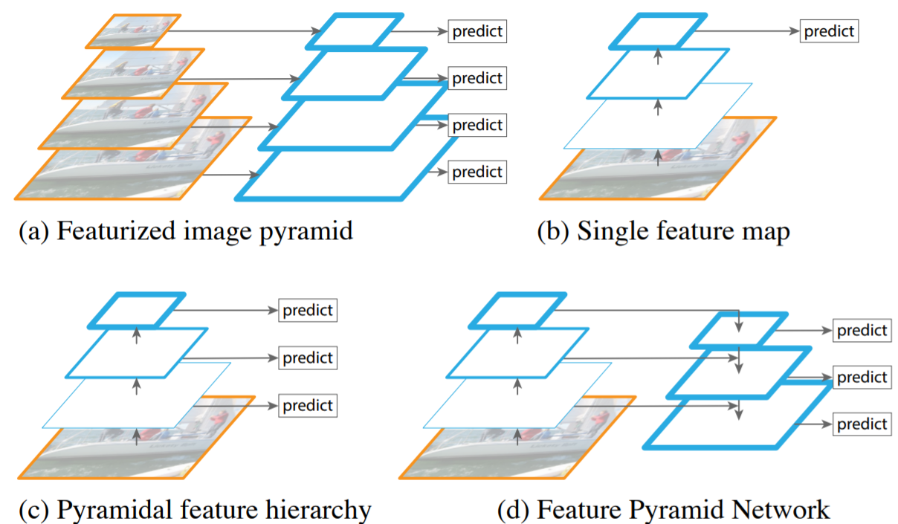
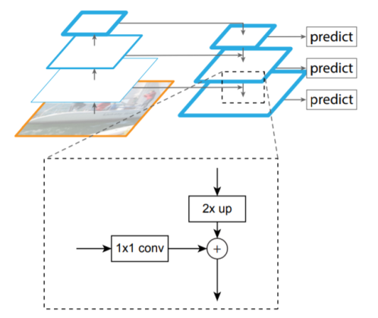
Feature pyramid networks
FPN(Lin, et al.cvpr2017), RON(kong et al. cvpr2017), DSSD(Fu et al. 2017)

Slide 55
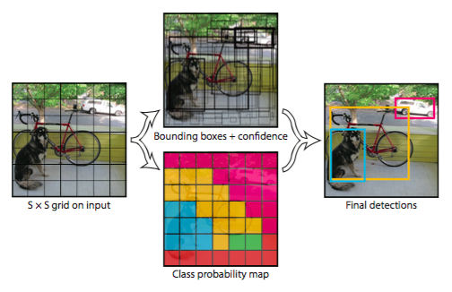
Single stage object detector
SSD, YOLO, DSSD, RetinaNet

Slide 56
Useful links for learning detection
RCNN/Fast R-CNN/Faster R-CNN: https://github.com/rbgirshick
YOLO/YOLOv2: https://pjreddie.com/darknet/yolo/
SSD: https://github.com/weiliu89/caffe/tree/ssd
R-FCN: https://github.com/daijifeng001/R-FCN
Tensorflow detector: https://github.com/tensorflow/models/tree/master/research/object_detection

